Slide 1


Final Engagement
Attack, Defense & Analysis of a Vulnerable Network

Slide 2
PRESENTED BY: LUCAS DOMANSKI

Slide 3
Table of Contents
This document contains the following resources:
Network Topology & Critical Vulnerabilities
Exploits Used
Avoiding Detect
Maintaining Access

Slide 4
Network Topology
& Critical Vulnerabilities
4

Slide 5
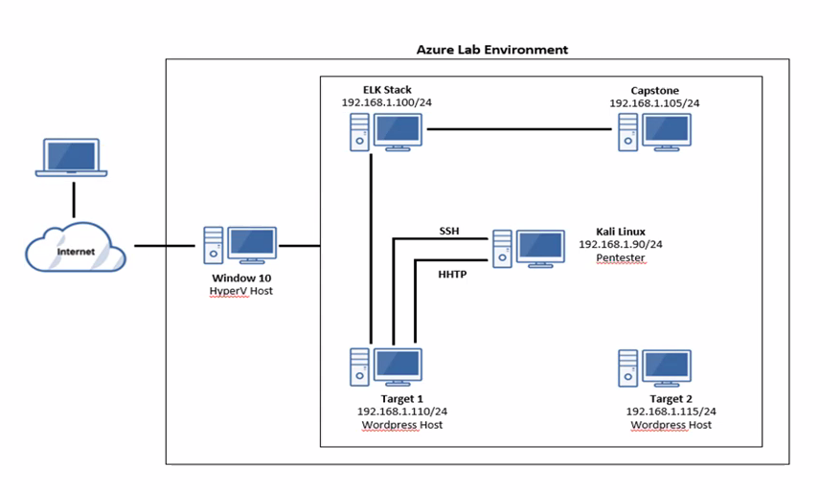
Network Topology
Network
Address Range:192.168.1.0/24
Netmask:255.255.255.0
Gateway:192.168.1.1
Machines
IPv4:192.168.1.90
OS:Debian Kali 5.4.0
Hostname:Kali
IPv4:: 192.168.1.105
OS:Linux
Hostname:Capstone
IPv4:192.168.1.100
OS:Ubuntu 18.04
Hostname:ELK Stack
IPv4:192.168.1.110
OS:Debian GNU/Linux 8
Hostname:Target 1
IPv4:192.168.1.115
OS:Debian GNU/Linux 8
Hostname:Target 2

Slide 6
Critical Vulnerabilities: Target 1
Our assessment uncovered the following critical vulnerabilities in Target 1.
Vulnerability | Description | Impact
Weak Password | A user has a feeble secret password that can undoubtedly be broken/cracked. | This secret password can be effectively brute forced or speculated by guessing.
Insecure MySQL Database | The hashed passwords for the users are stored in an unrestricted MYSQL database. | Anyone who can dump the mysql database, can gain user password hashes, which are easily reverse engineered.
Unrestricted privilege escalation | It is easy to gain access by implementing a python command to escalate privileges for users. | By implementing a python command we can give a user root access which they can have full access and do as they wish.
Code injection | using PHP commands to inject malicious codes | Attacks to the server can be carried out with Code injection.

Slide 7

Exploits Used
7

Slide 8
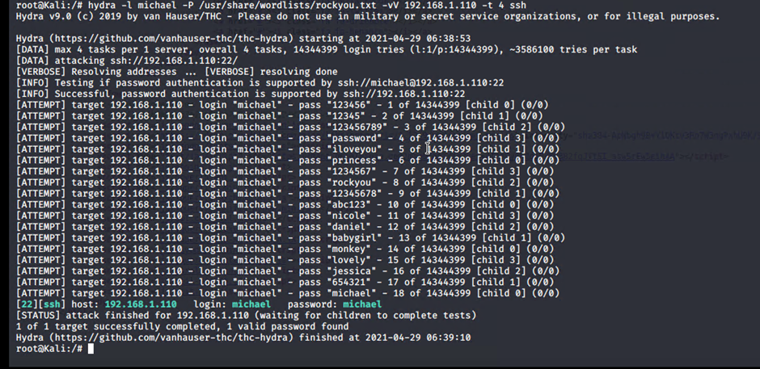
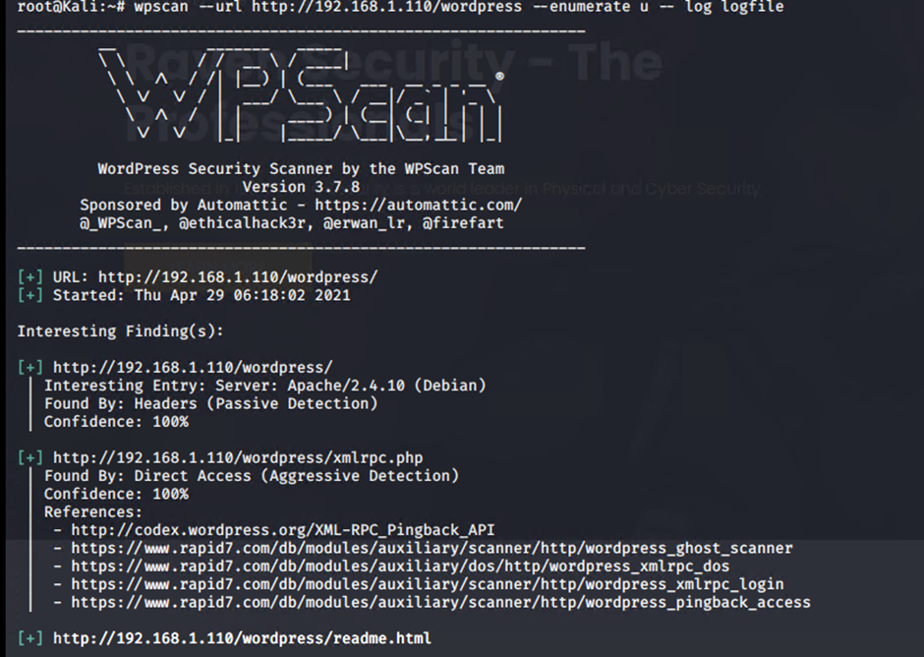
Exploitation: Weak password brute force
Summarize the following:
By utilizing WPscan we enumerated the users and discovered Michael and Steven.
By utilizing Hydra and the wordlist Rockyou.txt we broke Michael's powerless secret password which was "Michael".
The endeavor accomplishes a shell, by utilizing the command ssh michael@192.168.1.110

Slide 9
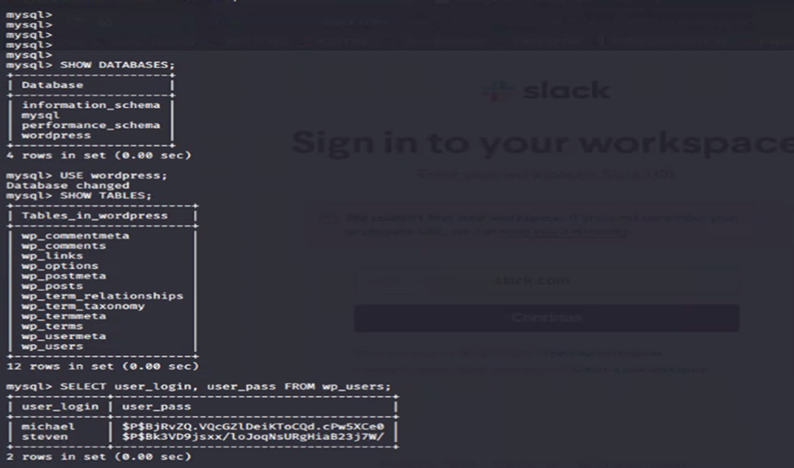

Exploitation: Unhashed password for root in wp-config.php
Summarize the following:
By Navigating to /var/www/html/wordpress we find the wp-config.php file.
This gave the log in and password R@v3nSecurity for the root user.
We can utilize this to open a mysql session and concentrate the table containing the hashed passwords for the users Michael and Steven.
By unhashing these hashes we find Steven’s password, pink84.
We use this to log in with a secure shell for Steven- ssh steven@192.168.1.110

Slide 10
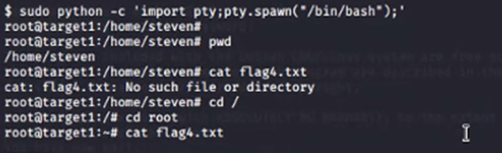
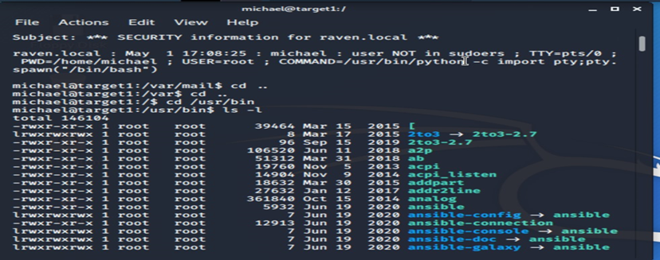
Exploitation: Unrestricted privilege escalation using code injection
Summarize the following:
We sign in as Steven through a shell utilizing the past advance, and we utilize a line of python that gives our hacked user Steven root privileges.
This gave us root access while logged in with a secure shell as Steven.
We can now get to the entirety of Steven's documents & files as well as run root orders or scripts from his user account.

Slide 11
Avoiding Detection
11

Slide 12
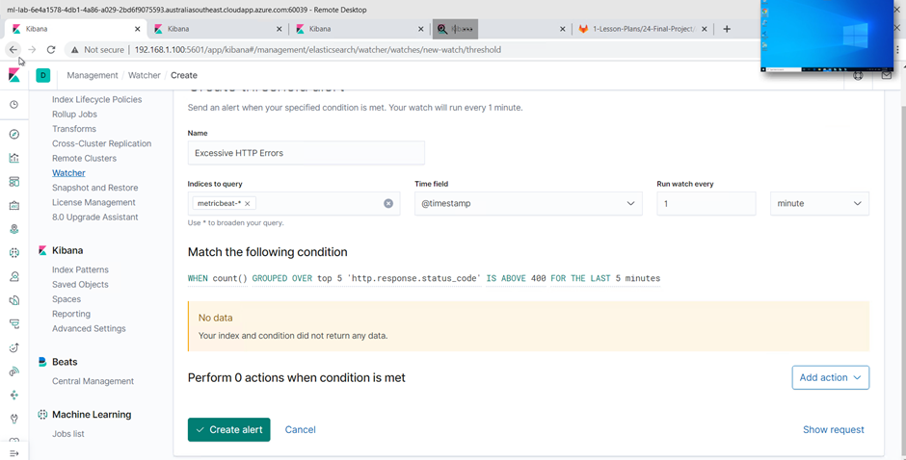
Stealth Exploitation of weak password brute force
Monitoring Overview
Which alerts detect this exploit?: Kibana: WHEN count() GROUPED OVER top 5 'http.response.status_code' IS ABOVE 400 FOR THE LAST 5 minutes
Which metrics do they measure? : The 5 users with the highest amount of http error responses for last 5 minutes.
Which thresholds do they fire at? : When the response code is over 400 (an error)
Mitigating Detection
Scattering the brute force endeavors throughout a more prominent timeframe to try not to stand out or create attention..
Utilizing a phishing assault to swipe a user's certifications/credentials..
In the event that actual access is conceivable, introduce a keylogger on a user's framework/system..

Slide 13
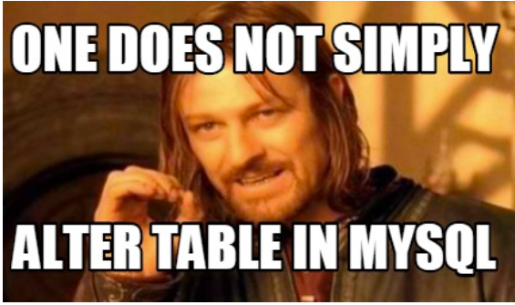
Insecure MYSQL database
Monitoring Overview
MySQL SHOW MASTER STATUS alert
In binary logs the event that double logs are empowered, you could compose a shell content to call mysql and do SHOW MASTER STATUS; If either the filename or file size changes, something changed. When identified, an email alert communicating that something has changed is sent.
When users who are unauthorized edit the MYSQL database access or dump data from it, an alert is triggered which an email notifying the user an unauthorized changes have been made.
Mitigating Detection
A component of safeguarding against SQL injection attacks is mitigating inadequate data sanitization. Because SQLi attackers can use unique character sequences to take advantage of a database, sanitizing data not to allow string concatenation is critical.
Connected to the principle of least privilege for SQL injection protection is configuring read access to database. If your organization only requires active users employing read-access, it’s undoubtedly easier to adopt. Nevertheless, this added step is imperative for stopping attackers from altering stored information.

Slide 14
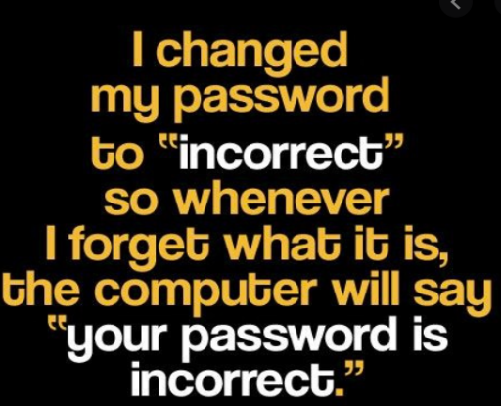
Stealth Exploitation of Unrestricted privilege escalation
Monitoring Overview
Implement a privilege escalation alert.
Monitoring unauthorized root access attempts as well as super user to filter thru files and make changes in user privileges.
When users without root access try to use the sudo command, or when a user changes unauthorized privileges an alert is triggered.
Mitigating Detection
Password policies It is essential to ensure users select unique, secure passwords and force them to change passwords periodically. Because this is difficult to enforce in practice, a good way to circumvent the insecure nature of passwords is to apply two-factor authentication, especially for sensitive systems and administrative accounts.
The Exabeam Security Management Platform is a quick and easy to deploy an AI-based behavioral analytics solution that helps to track user and account activities across different services. You can also use Exabeam to ingest the logs from other IT systems and security tools, analyze them, and identify and flag risky activities, threats, and other issues.

Slide 15
Maintaining Access
15

Slide 16

Backdooring the Target
Backdoor Overview
What kind of backdoor did you install (reverse shell, shadow user, etc.)?
Privilege Escalation exploiting SUDO Rights.
How did you drop it (via Metasploit, phishing, etc.)?
sudo python -c ‘import pty;pty.spawn(“/bin/bash”);’
How do you connect to it?
SSH to target 1 host access using Steve’s credentials.

